Slide 1

IMMUNITY
RUNGTA COLLEGE OF DENTAL SCIENCES AND RESEARCH,BHILAI
Basic concepts
PRESENTED BY:
Dr Sonika Bodhi
Reader
Dept. of Periodontology

Slide 2
SPECIFIC LEARNING OBJECTIVES
CORE AREAS | DOMAIN | CATEGORY
Introduction | AFFECTIVE | DESIRE TO KNOW
Definition | COGNITIVE | MUST TO KNOW
Classification of immune response | COGNITIVE | MUST TO KNOW
Organs of immune system | AFFECTIVE | DESIRE TO KNOW
Cells of immune system | COGNITIVE | MUST TO KNOW
Innate immune system | COGNITIVE | MUST TO KNOW
Complement system | COGNITIVE | MUST TO KNOW
Neutrophils | COGNITIVE | MUST TO KNOW

Slide 3
CONTENTS- PART I
Introduction
Definition
Classification of immune response
Organs of immune system
Cells of immune system
Innate immune system
  Complement system
  Neutrophils
Summary
References

Slide 4
CONTENTS- PART II
Adaptive immune system
  B cells and Antibodies: Types and Functions
  MHC molecules
  Antigen presenting cells
  T cells
Summary
References

Slide 5
Introduction
The immune system is an organization of cells and molecules with specialized roles in defending against infection caused by wide variety of pathogenic infectious agents with vastly differing natures, i.e. viruses, bacteria, fungi, protozoa and parasitic worms.

Slide 6
Cells and molecules involved in such protection constitute the IMMUNE SYSTEM and the response to introduction of a foreign agent is known as the IMMUNE RESPONSE
The beginning of the study of immunology was marked by discovery of the small pox vaccine in 1796 by Edward Jenner .

Slide 7
DEFINITION
IMMUNITY- derived from Latin immunis, meaning exemption from military service, tax payments or other public services.
Gherardi E. The Concept of Immunity
‘the state of having sufficient biological defences to avoid infection, diseases, or other unwanted biological invasion’.
Notes:
It is the capability of the body to resist harmful microbes from entering it.

Slide 8
Classification
IMMUNITY
INNATE
HUMORAL
ADAPTIVE
HUMORAL
CELLULAR
CELLULAR
.
Notes:
Humoral: comprised by complement
Cellular: consists of neutrophils, macrophages and natural killer cells
Humoral: consists of antibodies formed by B cells
Cellular: mediated by T cells

Slide 9
Adaptive immunity
Natural
Active
Antigens enter the body naturally :body induces antibodies.
Passive
Antibodies pass from mother to fetus via placenta or to infant via mother’s milk
Artificial
Active
Antigens are introduced in vaccine
Passive
Preformed antibodies in immune serum are introduced by injection

Slide 10
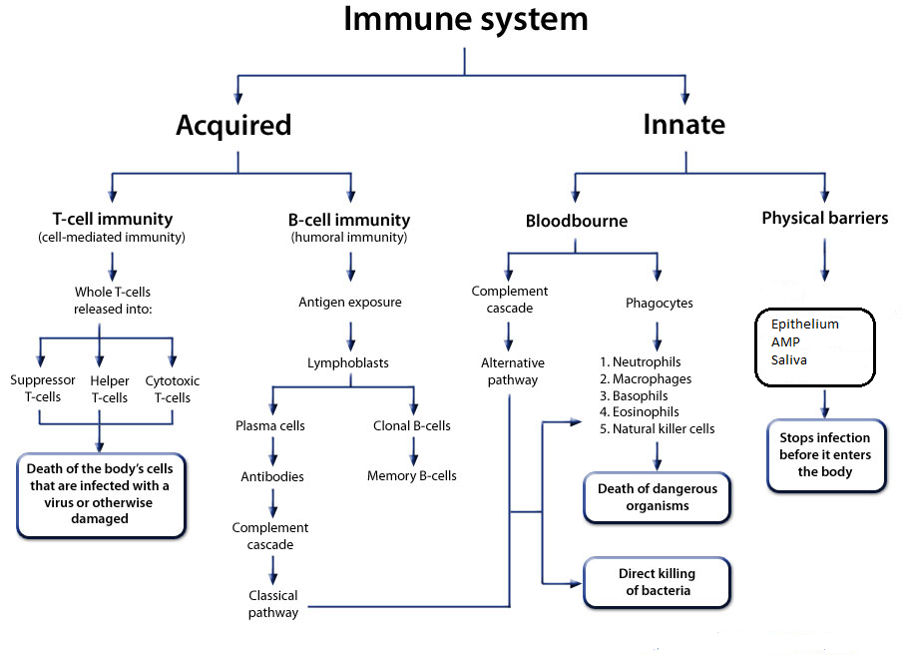

Slide 11
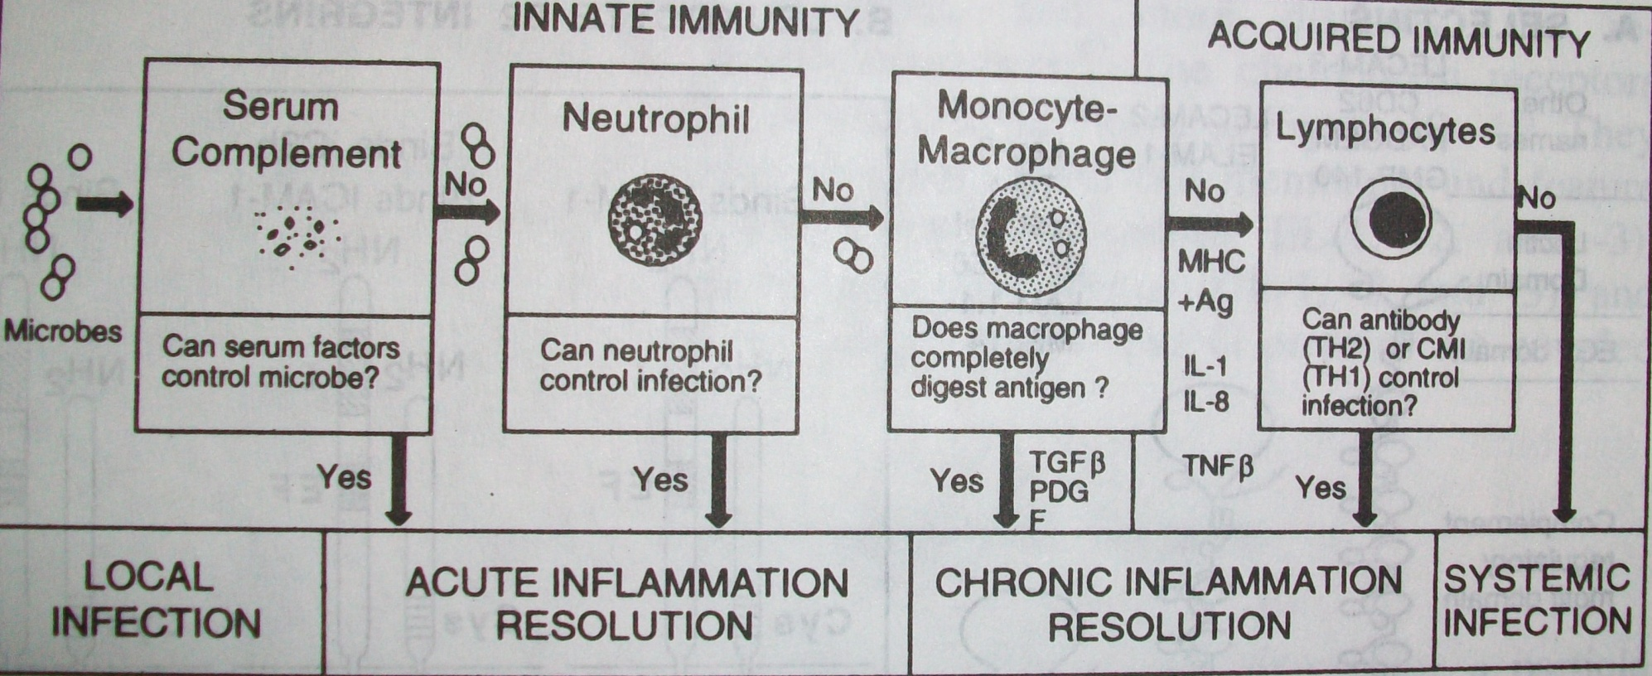

Slide 12
Organs of immune system
Primary lymphoid organs:
  Thymus
  Bone marrow
Secondary lymphoid organ:
  Lymph nodes
  Spleen
  MALT (Mucosa –Associated Lymphoid Tissue)
  GALT (Gut –Associated Lymphoid Tissue)

Slide 13
Cells of immune system
The main cells of the immune system are derived from the lymphoid and myeloid arms of the hematopoietic system.
Mast cells
Dermal dendrocytes
Peripheral dendritic cells
Neutrophils
Monocytes /macrophages
Lymphocytes
Natural killer (NK) cells

Slide 14
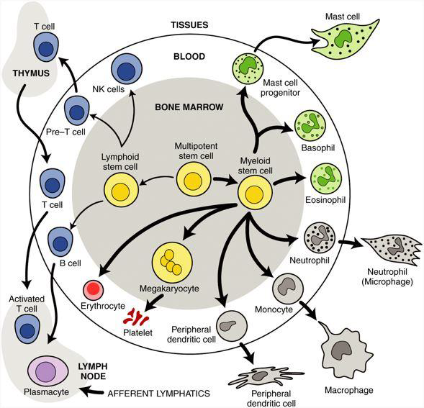

Slide 15
Immune responses are complex biologic networks in which PATHOGEN RECOGNITION, INNATE IMMUNITY, AND ADAPTIVE IMMUNITY are integrated and mutually dependent.

Slide 16
Innate immunity

Slide 17
The innate immune system, also known as non-specific immune system and first line of defense, is a subsystem of the overall immune system that comprises the cells and mechanisms that defend the host from infection by other organisms in a non-specific manner.

Slide 18
The recognition of pathogenic microorganisms and the recruitment of effector cells (e.g., neutrophils) and molecules (e.g., the complement system) are central to effective innate immunity.

Slide 19
Innate immune responses are orchestrated by a broad range of cytokines, chemokines, and cell surface receptors, and the stimulation of innate immunity leads to a state of inflammation.
If innate immune responses fail to eliminate infection, then the effector cells of adaptive immune responses (lymphocytes) are activated.

Slide 20
The recognition of infectious agents in innate immunity is mediated by germline-encoded receptors called pattern recognition receptors (PRRs).

Slide 21
These receptors generally recognize conserved features of infectious agents that are often shared by different classes of microbes, these microbial features are called pathogen-associated molecular patterns (PAMPs).
PAMPs directly or indirectly stimulate innate immune responses by acting as agonists for PRRs.
Janeway, C.A. Jr., 1989

Slide 22
SALIVA
Saliva, has an important role in the maintenance of oral and dental health.
The action of shear forces associated with saliva flow is important for preventing the attachment of bacteria to the dentition and oral mucosal surfaces

Slide 23
Human saliva also contains numerous molecular components that contribute to host defenses against bacterial colonization and periodontal disease

Slide 25
EPITHELIAL TISSUES
The epithelial tissues play a key role in host defense because they are the main site of the initial interactions between plaque bacteria and the host, and they are also the site of the invasion of microbial pathogens.
The keratinized epithelium of the sulcular and gingival epithelial tissues provides protection for the underlying periodontal tissue in addition to acting as a barrier against bacteria and their products.

Slide 26
By contrast, the junctional epithelium has significant intercellular spaces, it is not keratinized, and it exhibits a higher cellular turnover rate. These properties render the junctional epithelium permeable, thereby allowing for the inward movement of microbes and their products and the outward movement of GCF and the cells and molecules of innate immunity. Furthermore, the spaces between the cells of the junctional epithelium widen with inflammation, which results in increased GCF flow

Slide 27
Epithelial cells also constitutively express antimicrobial peptides, and the synthesis and secretion of these molecules is up-regulated in response to periodontal bacteria.

Slide 28
Neutrophils are also a source of antimicrobial peptides (i.e., α-defensins).
Antimicrobial peptides are small, polycationic peptides that disrupt bacterial cell membranes and thereby directly kill bacteria with broad specificity.

Slide 29
Epithelial cells that are directly stimulated with bacterial components and cytokines can produce MMPs, which contribute to a loss of connective tissue. Epithelial cells also secrete a range of cytokines in response to periodontal bacteria (e.g., P. gingivalis, A. actinomycetemcomitans, F. nucleatum, Prevotella intermedia), which signal immune responses.

Slide 30
These include the proinflammatory cytokines IL-1β, TNF-α, and IL-6, as well as the chemokine IL-8 (CXCL8) and the monocyte chemoattractant protein-1, which serve to signal neutrophil and monocyte migration from the vasculature into the periodontal tissue.

Slide 31
GCF
Gingival crevicular fluid originates from the postcapillary venules of the gingival plexus. It has a flushing action in the gingival crevice, but it also likely functions to bring the blood components (e.g., neutrophils, antibodies, complement components) of the host defenses into the sulcus.

Slide 32
Pathogen recognition and activation of cellular innate responses
If plaque bacteria and their products penetrate the periodontal tissues, specialized “sentinel cells” of the immune system recognize their presence and signal protective immune responses.
These cells include macrophages and dendritic cells, which express a range of pattern recognition receptors (PRRs) that interact with microbe-associated molecular patterns.

Slide 33
The activation of PRRs activates innate immune responses to provide immediate protection, and adaptive immunity is also activated with the aim of establishing a sustained antigen-specific defense.
Excessive and inappropriate or dysregulated immune responses lead to chronic inflammation and the concomitant tissue destruction associated with periodontal disease.

Slide 34
Complement system
The complement system was discovered in 1893 by the Belgian scientist Jules Bordet, who called it ‘alexine’.
Term ‘complement’ coined by Paul Ehrlich.
Complement proteins were demonstrated in GCF by Shillitoe and Lehner in 1972.

Slide 35
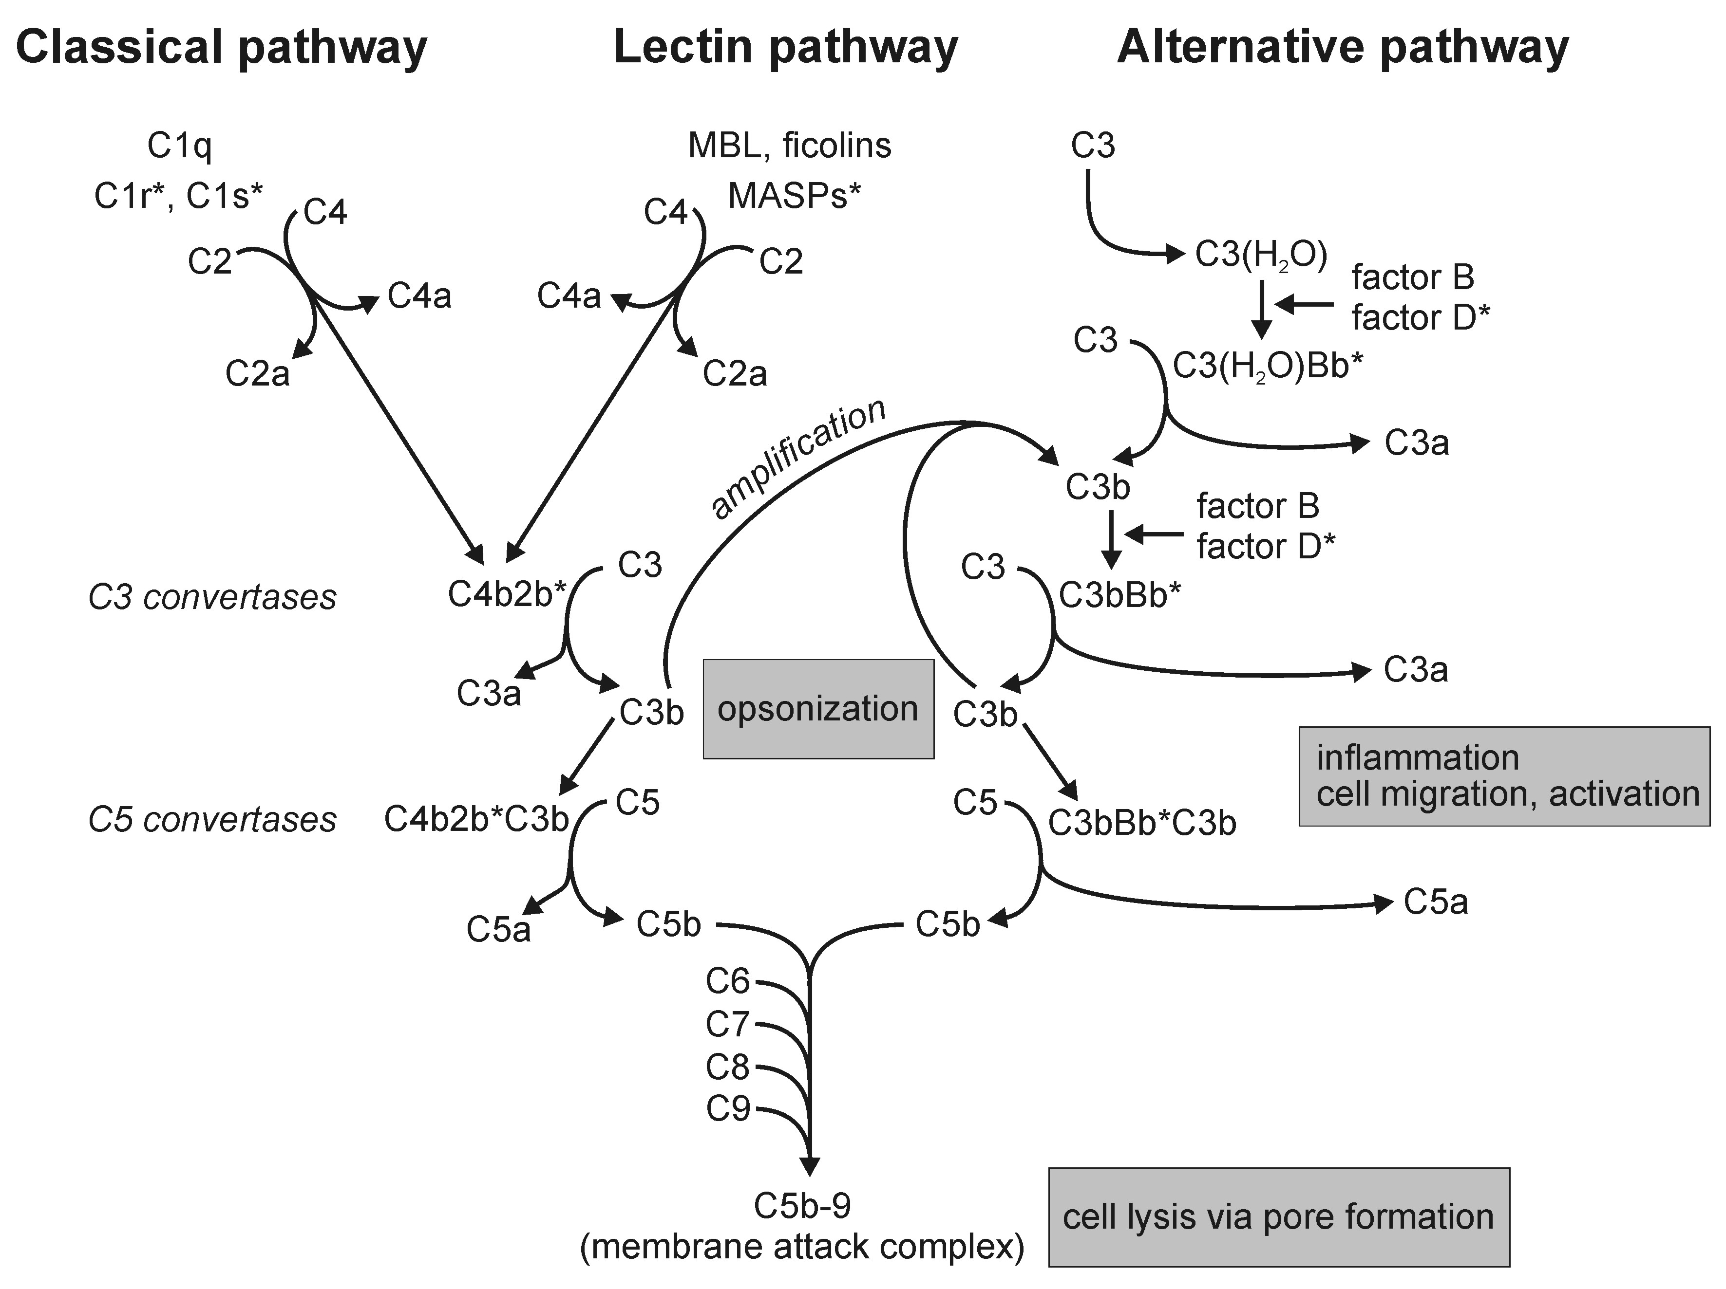

Slide 36
Functions of the Complement System
Opsonization of foreign material:
Lysis of foreign material:
Inflammatory processes
Removal of immune complexs
Bridging innate and adaptive immune responses

Slide 37
Neutrophils
Neutrophils, also known as polymorphonuclear leukocytes (PMNs), are the predominant leukocyte in blood, accounting for about two thirds of all blood leukocytes (4000-8000 cells/mm3).
Formed in the bone marrow, migrate to the blood stream, and about 12 hours later move into the tissues , where they die.
Life span is only about a day.

Slide 38
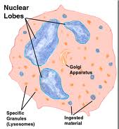
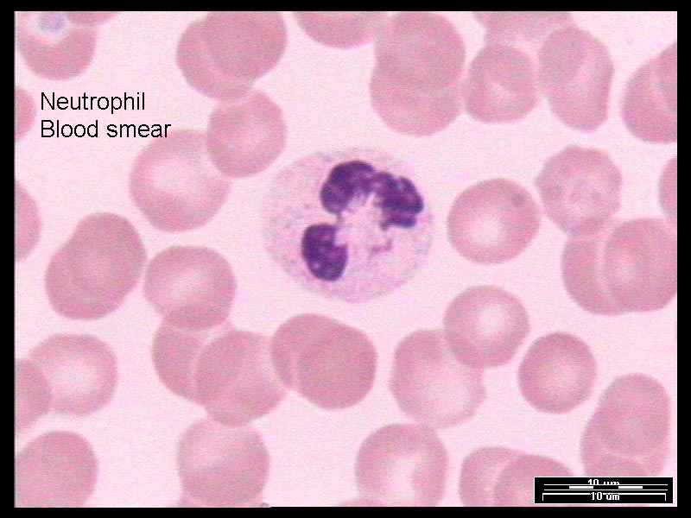
Structure

Slide 39
Electron microscopy shows 2 types of cytoplasmic granule:
Primary granules: contain myeloperoxidase and lysosyme.
Secondary granules: contain lysosyme, collagenase, lectoferrin.
Cytoplasm also contain large amount of glycogen.

Slide 40
Lysozyme is an enzyme that possesses enzyme-dependent bactericidal activity, enzyme-independent bactericidal and fungicidal activity.
Lactoferrin is a bacteriostatic compound that contains a bactericidal peptide domain, lactoferricin.

Slide 41
Neutrophils possess receptors for metabolites of the complement molecule C3, designated complement receptors 1, 3, and 4 (CR1, CR3, CR4) and C5 (C5aR).
They also possess receptors for IgG antibody (FcγR).
These receptors enable neutrophils to (1) be recruited from the blood, (2) locate offending agents, and (3) ingest (phagocytose) and kill the offending agents.

Slide 42
Transendothelial migration
The directed movement of leukocytes from the blood into the local tissues is central to inflammation.
Transendothelial migration is a selective interaction between leukocytes and endothelium that results in the leukocyte pushing its way between endothelial cells to exit the blood and enter the tissues.

Slide 43
In a local inflammatory response, transendothelial migration occurs in the following sequential phases:
Rolling,
An insult to local tissue,
Signaling the endothelium,
Increased rolling,

Slide 44
5. Signal for rolling arrest
6. Strong adhesion (arrested rolling)
7. Zipper phase

Slide 46
Basement degradation
Leukocytes accumulate briefly between the basement membrane and the endothelial cell. This pause may reflect a period of secretion of proteases to degrade the basement membrane .
Leukocytes possess several proteases, including urokinase plasminogen activator receptor (uPAR) that leads to the activation of collagenase, which then may degrade the basement membrane and enable the leukocyte to enter the connective tissues.

Slide 47
Chemotaxis
Once the leukocyte enters the connective tissue, it must be able to locate and migrate to the site of insult.
This is accomplished by chemotaxis, which depends on the leukocyte’s ability to sense a chemical gradient across its cell body and migrate in the direction of increasing concentration.
The phagocyte senses only a limited number of chemicals: chemotaxins for which it has receptors. The receptors for chemotaxis belong to a family called the G-protein coupled family.
formyl-methionyl peptides:only bacterial chemotaxin

Slide 48
To migrate toward a target, leukocytes assume an asymmetric or polarized shape rather than the rounded morphology evident in blood.
Notes:
Neutrophils polarize, forming an anterior lamellipod and a posterior uropod. Cytoplasm appears to squirt through a contractile ring. Neutrophils exhibit strikingly sensitive chemotaxis and can detect a 1% gradient over the length of its cell body at nanomolar concentrations.

Slide 49
Neutrophils and monocytes/macrophages are the only cells efficient enough at phagocytosis to be considered “professional phagocytes.”
Phagocytosis results in the eventual containment of a pathogen within a membrane-delimited structure, the phagosome.

Slide 50
Each neutrophil possesses two main types of lysosomes, or granules: specific granules, designed for both extracellular and intraphagolysosomal secretion, and azurophil granules, designed mainly for intraphagolysosomal secretion.

Slide 51
Less than 30 seconds after phagocytosis, neutrophils secrete specific granule components into the phagolysosome. Specific granules contain several microbiocidal components, including lysozyme and lactoferrin.
Neutrophils secrete azurophil granule components into the phagolysosome minutes after the secretion of the specific granules.

Slide 52
Phagocytes kill bacteria through two broad categories of killing mechanisms.
  Oxidative mechanisms
  Nonoxidative mechanisms

Slide 53
Oxidative mechanisms require
the presence of oxygen and
an oxidation-reduction potential, Eh, at or above -160 mV.

Slide 54
In the presence of oxygen, neutrophils exert intense microbicidal activity by forming toxic, reduced-oxygen metabolites such as superoxide anion (O2-) using the NADPH oxidase system.
The superoxide anion also contributes to the formation of hydrogen peroxide (H₂O₂), which is capable of diffusing across membranes.

Slide 55
Inside a target cell, H₂O₂may be further reduced to the hydroxyl radical, which can cause DNA damage. More importantly, H₂O₂ is a substrate for myeloperoxidase (MPO).
In the presence of H₂O₂ and chloride, MPO catalyzes the formation of hypochlorous acid (HOCl).

Slide 56
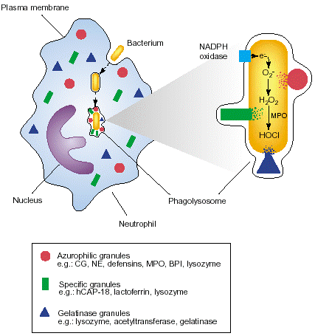

Slide 57
Nonoxidative cells:
killing requires phagosome-lysosome fusion. This process involves the movement toward and subsequent membrane fusion of the lysosome with the phagosome, which forms a phagolysosome. This results in the secretion of lysosomal components into the phagolysosome.

Slide 58
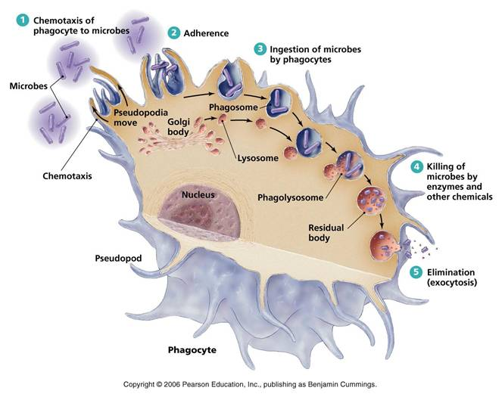

Slide 59
SUMMARY
The immune system is composed of the lymphatic system, blood proteins (known as immunoglobulins), specialized white blood cells such as lymphocytes, as well as the organs that produce these cells and the blood vessels that transport them. All are designed to react rapidly to disease-producing organisms and their toxins.

Slide 60
REFERENCES
Newman MG, Takei HH, Klokkevold PR, Carranza FA. Carranza’s clinical periodontology, 10th ed. Saunders Elsevier; 2007.
Lindhe J, Lang NP and Karring T. Clinical Periodontology and Implant Dentistry. 6th ed. Oxford (UK): Blackwell Publishing Ltd.; 2015.
Newman MG, Takei HH, Klokkevold PR, Carranza FA. Carranza’s clinical periodontology, 13th ed. Saunders Elsevier; 2018.

